Slide 1
Microsoft Makes a Movie
Richard Hinds
Will Norton

Slide 2
Summary
Descriptive analysis of recent movie data uncovered movie production criteria to optimize net earnings. We recommend:
Producing an Adventure movie
Producing a big budget movie (>$150 million)
Selecting talent from our curated list

Slide 3
Outline
Business Problem
Methods
Results
Conclusions

Slide 4
Business Problem
Which franchise can maximize net earnings?
Notes:
Recent ATVI acquisition brings 6 stellar franchise ripe for movie making

Slide 5
Methods
Correlate genre with net earnings
Correlate budget with net earnings
Correlate talent with net earnings

Slide 6
Results
Adventure movies dominate
Notes:
Consider combining top genres to maximize earnings

Slide 7
Results
Big Budget = Big Earnings

Slide 8
Results
Top talent performs top of chart

Slide 9

Conclusions
Best performing genres map to Activision Blizzard’s top franchises: WoWarcraft, Starcraft, and Candy Crush
Big budget maximizes big returns
Call Ty Simpkins agent now
Future Improvements
Correlate movie rating with net earnings
Integrate contribution of merchandise to net earnings analysis

Slide 10
Thank you
Richard Hinds
Will Norton

Slide 12
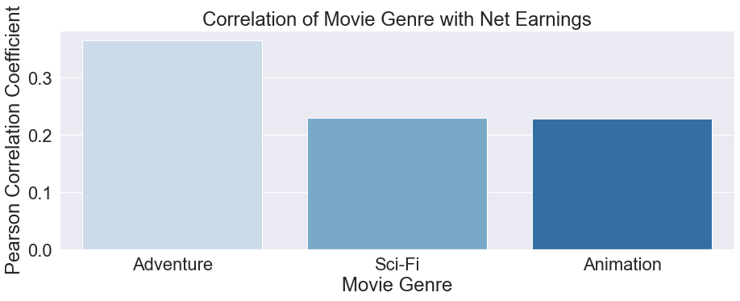
Results
Genres
Moderate influence on success
Best bet is an adventure movie
Can combine multiple genres

Slide 13
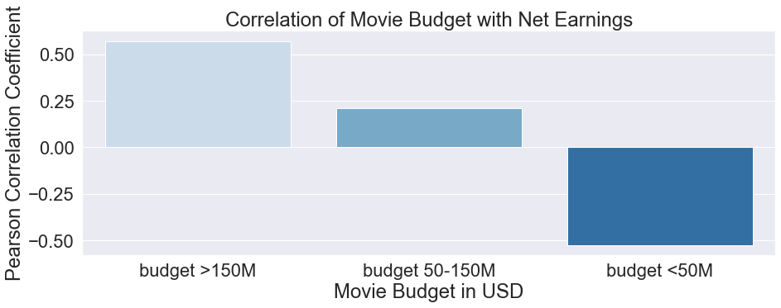
Big Budget = Big Earnings

Slide 14
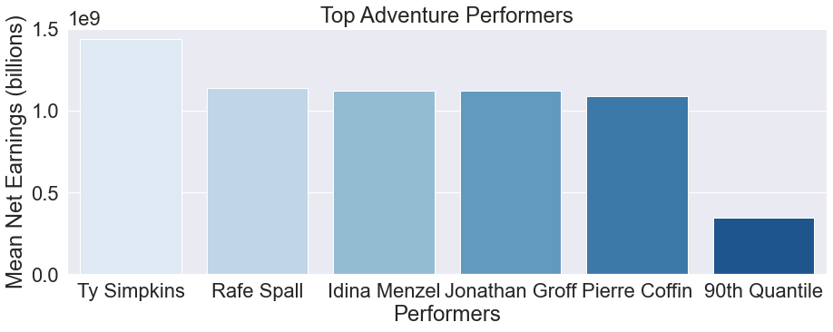
How valuable are the top performers?
Some performers were in movies that earned far more than their peers
Results may not be useful due to small sample size
Further research needed

Slide 15
Conclusions
The best performing genres, Adventure and Action, match Activision Blizzard’s top franchises: Warcraft, Call of Duty, and Starcraft
A big budget maximizes the chances of big returns
Top performers are an uncertain bet
Future Improvements
Utilize larger database & modeling to examine earning potential resulting from top performers
Examine what elements of production budgets are tied to success
Look at the value of movies to promote sales of games, toys, etc

